Slide 1

AMERICAN INTERNATIONAL UNIVERSITY BANGLADESH
FACULTY OF ENGINEERING MICROPROCESSOR AND EMBEDDED SYSTEMS COURSE INSTRUCTOR: TAHSEEN ASMA MEEM
Spring:2020-2021 Section: G

Slide 2
Presented by
SL. | Name | ID | Program
01 | Shome, Shourav | 18-36933-1 | CSE
02 | Ety, Rabeya Akter | 18-36963-1 | CSE
03 | Dohan, Din Mohammad | 17-34465-2 | CSE
04 | Sumaiya Binte Zilani Choya | 18-362351 | CSE
05 | Faiaz, Ben Reza | 18-36655-1 | CSE

Slide 3
Presentation topic:
Home Safety System using Fire Alarm,Gas Detector and Water Sprinkler

Slide 4
Introduction
Background Information
Increase in fire outbreak.
High risk of damage or life loss because of unexperienced evacuation system.
No quick action to stop fire from spreading.
Overview of this project
Aims to develop microcontroller-based fire alarm and gas detector
Sense fire, smoke and temperature at the site of disaster by using flame and smoke sensors.
The system can function by itself
Create cheap but Reliable Fire safety system.

Slide 5
Component list of the Project
Equipment | Quantity
Arduino Uno | 1
Flame Sensor | 1
Gas Sensor | 1
Buzzer | 1
DC Motor | 2
LED | 3
L293D | 1
Sprinkler | 1
Resistor | 3
Contents
Performance
Contents
Performance
Contents
Performance

Slide 6
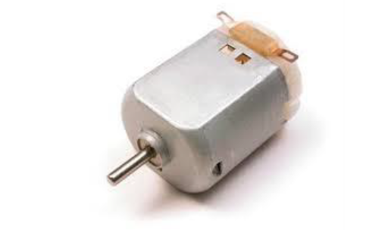
DC Motor
A DC motor (Direct Current motor) is the most common type of motor. DC motors normally have just two leads, one positive and one negative. If two leads are directly connected to a battery, the motor will rotate. If the leads are switched, the motor will rotate in the opposite direction.
Buzzer
It is an electronic used to give alarm sound as it is programmed

Slide 7
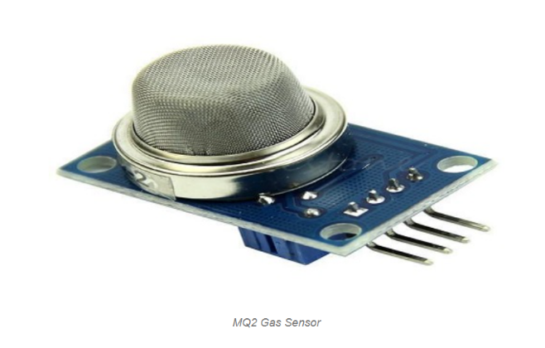
Gas Sensor
MQ2 gas sensor is an electronic sensor used for sensing the concentration of gases in the air such as LPG, propane, methane, hydrogen, alcohol, smoke and carbon monoxide.
It is commonly an unwanted by-product of fires.
Smoke Detectors are very useful in detecting smoke or fire (GAS) in buildings, and so are the important safety parameters.
The smoke sensor detects smoke and provides output to the MCU.

Slide 8
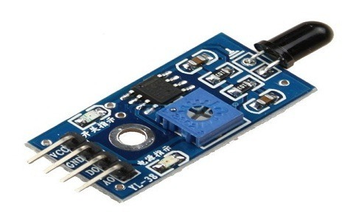
Flame Sensor
A flame detector is a sensor designed to detect and respond to the presence of a flame or fire.
This sensor/detector can be built with an electronic circuit using a receiver like electromagnetic radiation. This sensor uses the infrared flame flash method, which allows the sensor to work through a coating of oil, dust, water vapor, otherwise ice.

Slide 9
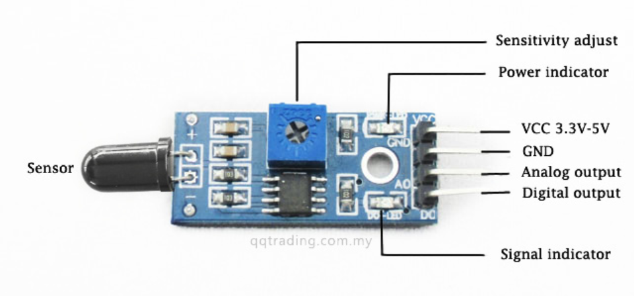
Flame Sensor
Module: The pin configuration of this sensor is shown below. It includes four pins which include the following. When this module works with a microcontroller unit then the pins are
Pin1 (VCC pin): Voltage supply rages from 3.3V to 5.3V
Pin2 (GND): This is a ground pin
Pin3 (AOUT): This is an analog output pin (MCU.IO)
Pin4 (DOUT): This is a digital output pin (MCU.IO)

Slide 10

L293D
Pin description of L293D
L293D is a Motor driver integrated circuit which is used to drive DC motors rotating in either direction.
It is a 16-pin IC which can control a set of two DC motors simultaneously. It means that we can control two DC motor with a single L293D IC.
Dual H-bridge Motor Driver integrated circuit(IC). The L293D uses 5V for its own power and external power source is needed to drive the motors, which can be up to 36V and draw up to 600mA.

Slide 11
Block Diagram
Power Supply (12V)
Flame Sensor
ARDUINO
UNO
Left Motor
L293D Motor Driver
Right Motor
Pump Motor
Gas Sensor
Buzzer
LED RED
Power Supply
LED GREEN
LED BLUE

Slide 12
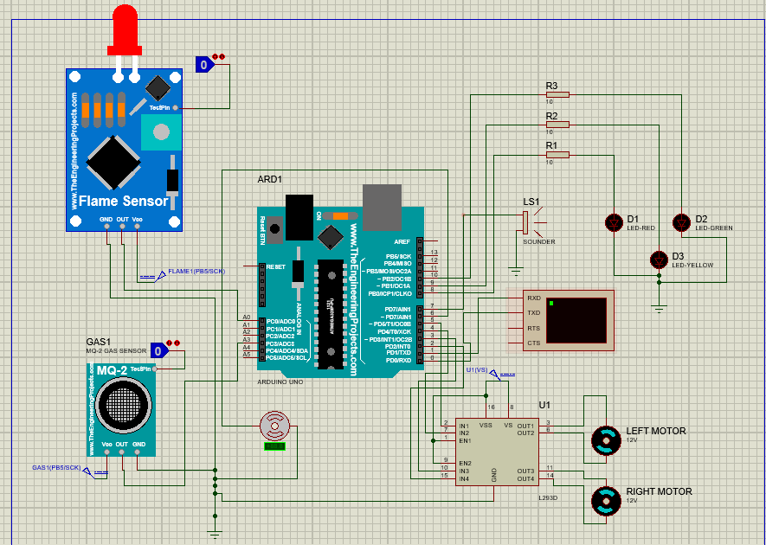
Software Implementation

Slide 13
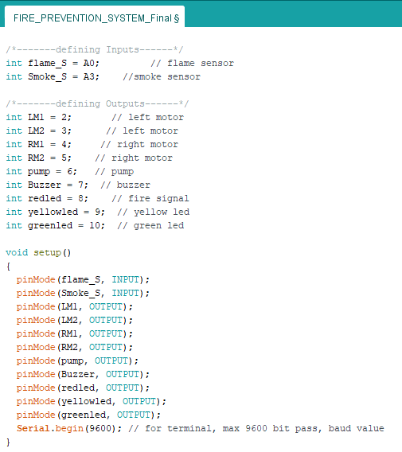
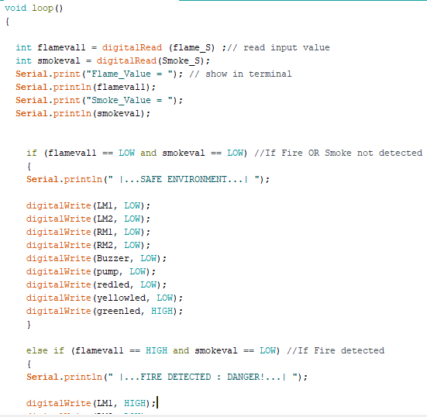
Simulation Codes

Slide 14
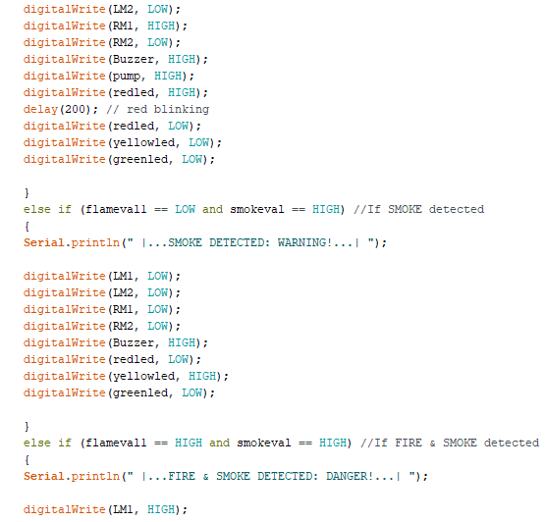

Simulation Codes

Slide 15
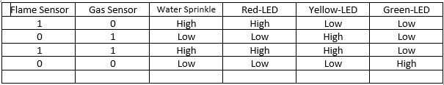
Result Of Data Collection

Slide 16
Result And Discussion
In this project, a method has been implemented which is capable of detecting flames & smokes and extinguishing them successfully.
In our system there are two motor, left motor and right motor. This can move anticlockwise. The motors and Arduino code work together to control the movement of the motor.
If any of the flame sensors or smoke sensor are triggered , then buzzer will start to buzz & warning about the danger environment will be displayed on the Virtual Terminal & safe environment will be shown in case of no such detection.
This process will be continued until the fire or smoke has been extinguished completely.

Slide 17
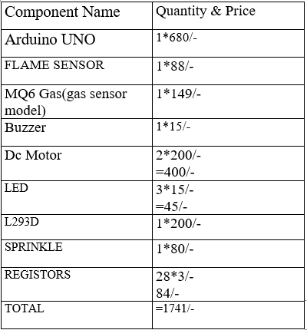
Cost Analysis

Slide 18
Advantages
To detect the the fire source
Capability of sensing accurately
Reduce fire injuries
Reliable and economical.
Not sensitive to weather conditions.

Slide 19
Disadvantages
No remote control for the environment
Motors are battery connected
It is not used to put out large fires.

Slide 20



Impact of the project on the society
Prevent accidents
Disaster protection
Instantly responsive
Reduced work
Low maintenance cost

Slide 21
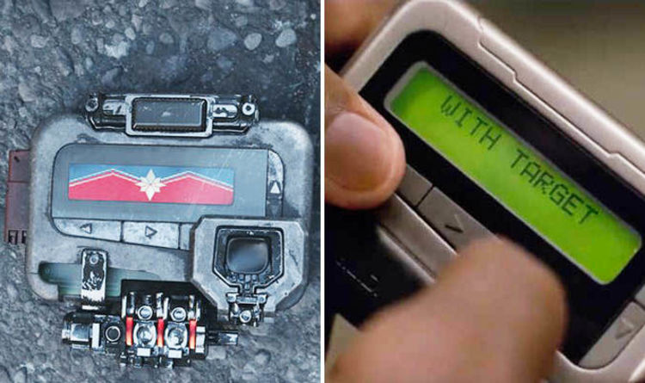
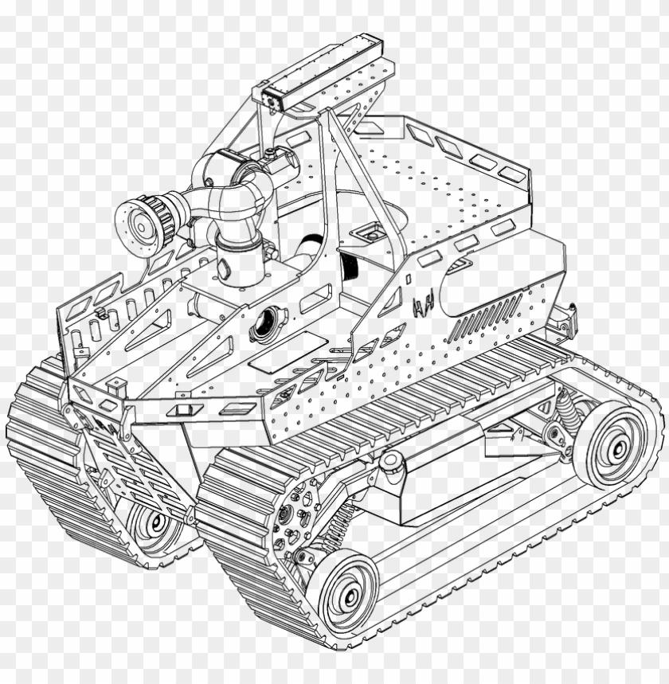
Future work
Transformation of the prototype to a practical device.
Adding SMS alert system can instantly send notification to the owner.
Adding GPS sensor can send location with the notification to the nearest Fire station.
Adding sensor which will be able to cut out the electricity connection.
The device can be converted to a robot which will bring more flexibility.

Slide 22

Conclusion
Detects smoke and fire flames.
Reduce the possibility of injury.
Reduce financial losses
Reliable and economical
Implementation takes up less space
It is used to solve the fire extinguisher problem
It works in places where humans are unable to enter

Slide 23
References
[1] A.K. Singh, and Harshit Singh, “Forest Fire Detection through Wireless Sensor Network using Type-2 Fuzzy System”, International Journal of Computer Applications,” vol 52– No.9, pp. 19-23, August (2012.)
[2] Al-Abbass Y. Al-Habashneh, Mohamed H. Ahmed, and Taher Husain, “Adaptive MAC Protocols for Forest Fire Detection Using Wireless Sensor Networks ,” in proceeding of IEEE electrical and communication system engineering confrence’, (2009),pp.329-333.
[3] Apeh S.T, Erameh K.B2 and Iruansi U. (2014) “Design and Development of Kitchen Gas Leakage Detection and Automatic Gas Shut off System”, Journal of Emerging Trends in Engineering and Applied Sciences (JETEAS).Scholarlink Research Institute Journals, pp. 222-228.
[4] `ArnoldoDíaz-Ramíreza, Luis A. Tafoyaa, Jorge A. Atempa, and Pedro Mejía-Alvarezb, “Wireless Sensor Networks and Fusion Information Methods for Forest Fire Detection,” in Science direct on Electronics Engineering and Computer Science ’, 2012, pp.69-79.

Slide 24
Thank you

